Slide 1
Image Inpainting via Conditional Texture and Structure Dual Generation
(ICCV 2021)
Xiefan Guo, Hongyu Yang, Di Huang (2021)

Slide 2
Image Inpainting
Image Inpainting
Image inpainting is the process of genarating or reconstructing distorted regions of an Image.
Challenges : (Previous methods)
The cases with large corruptions, generally suffer from distorted results.
Previous methods have a common drawback in recovering the global structure of the image.
Previous methods involving structures are sensitive to the accuracy of structures (e.g. edges and contours) which is not easy to guarantee.

Slide 3
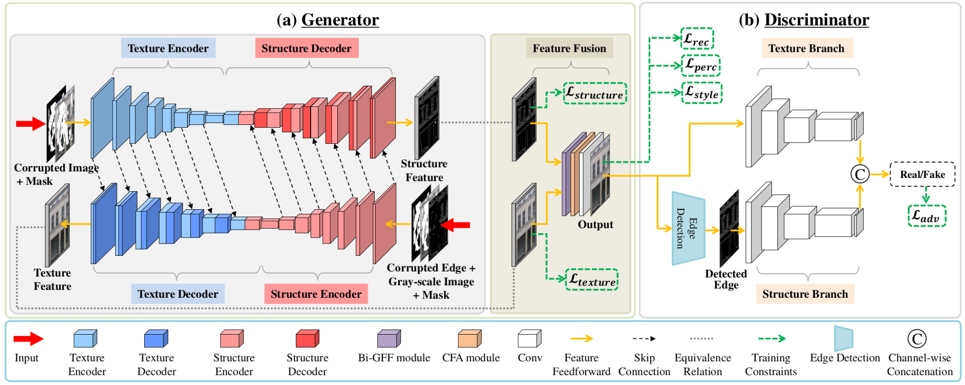
Architecture
Structure-constrained texture synthesis
Texture-guided structure reconstruction
Bi-directional Gated Feature Fusion (Bi-GFF)
Contextual Feature Aggregation (CFA)
Notes:
the left branch focuses on texture features and the right branch targets structure features.
Different from the case in the texture branch, it is in-tractable to optimize the adversarial loss of the structure branch only with the detected edge map, mainly due to the sparse nature of the edge. We therefore adopt the gray-scale image as an additional condition and feed the paired data as the input in the structure branch

Slide 4
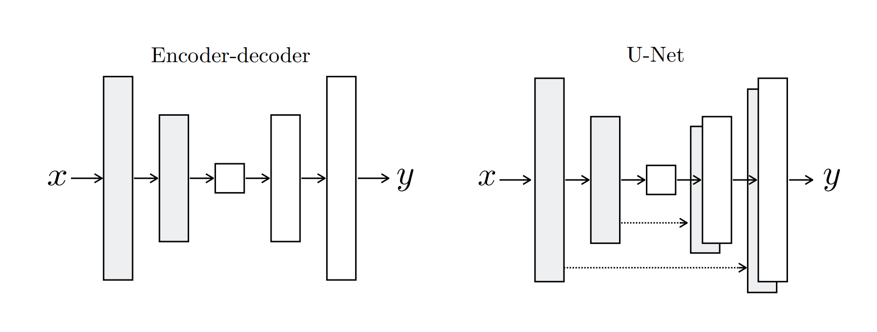
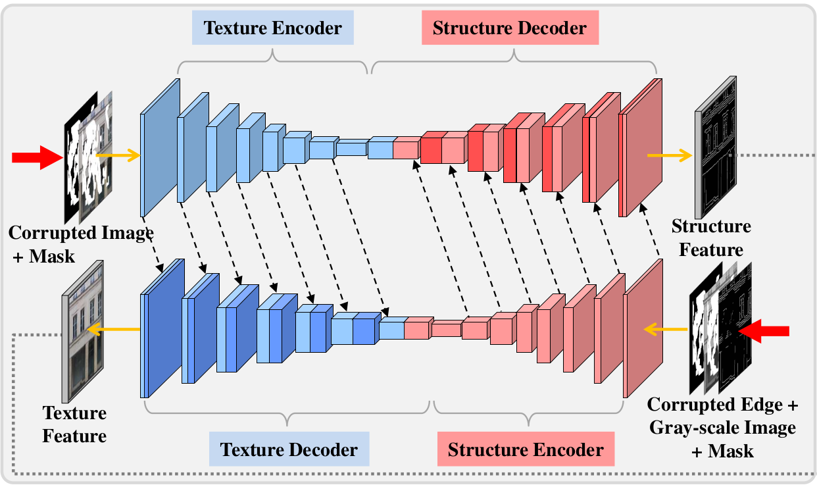
Generator :
Generator
Two-stream generator which jointly synthesizes image textures and structures.(Partial Convolutions)
U-Net Variant
Encoder-decoder
Skip Connections
Input : The corrupted image and its corresponding edge map.
Output : Texture and structure Feature map.
‹#›
Notes:
U-Net is an encoder-decoder, with same-size inputs and outputs.
Skip Connections - help the decoder learn details from the encoder directly also the encoder learn from more gradients flowing from decoder. skip connections are utilized to produce more sophisticated predictions by combining low-level and high-level features at multiple scales.

Slide 5
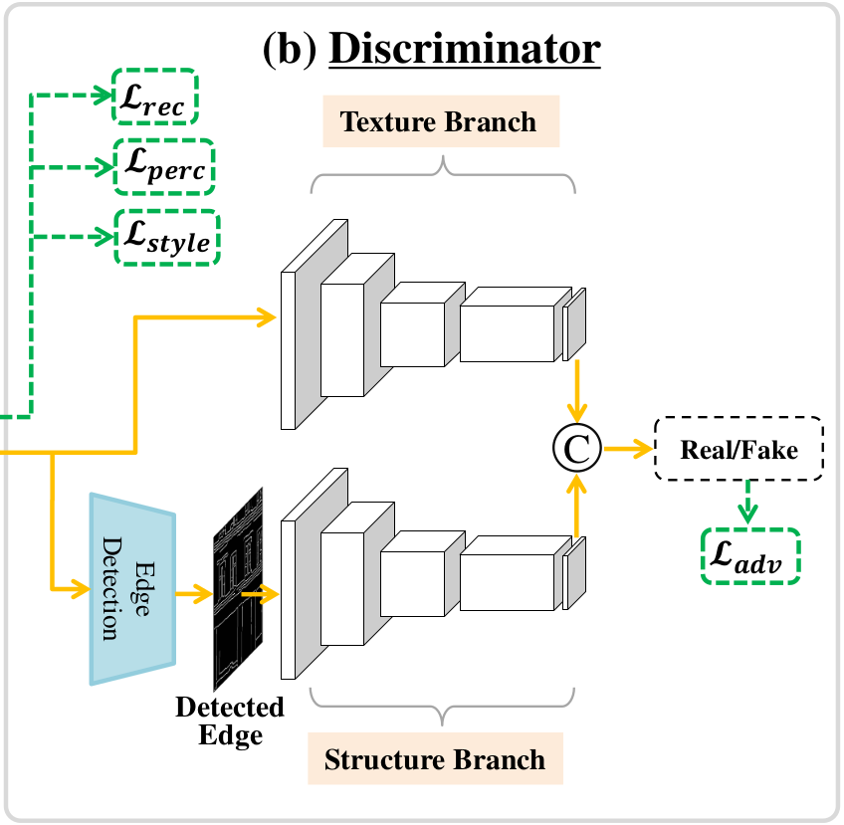
Discriminator:
Discriminator
Two-stream discriminator to distinguish images by feature statistics of both texture and structure.
Input : Texture and structure Feature map.
Output : Real/Fake.
Notes:
At the decoding stage, the texture decoder synthesizes structure-constrained textures by borrowing structure features from the structure encoder.
the structure decoder recovers texture-guided structures by taking texture features from the texture encoder.
The texture branch includes three convolution layers with the kernel size of 4 and stride of 2, tailed by two convolution layers with the kernel size of 4 and stride of 1. We use the Sigmoid non-linear activation function at the last layer and the Leaky ReLU with the slope of 0.2 for other layers.
The structure branch shares the same pattern as the upper stream, where the input edge map is detected by a residual block [6] followed by a convolution layer with the kernel size of 1.
the outputs of the two branches are concatenated in the channel dimension.

Slide 6
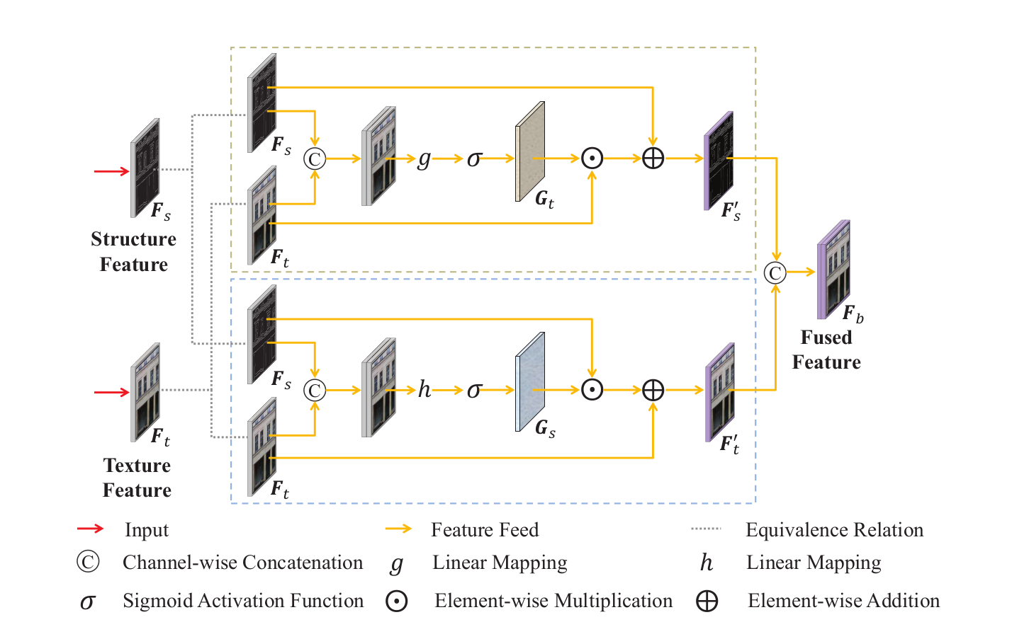
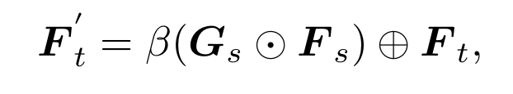
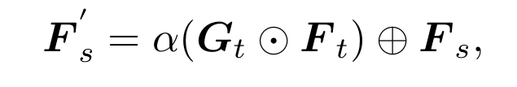
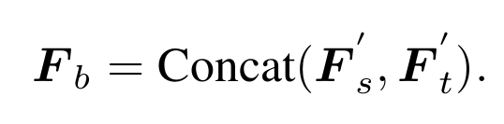
Bi-GFF :
Bi-directional Gated Feature Fusion (Bi-GFF)
Notes:
To enhance the consistency of the rebuilt structures and textures, the feature maps output by the two branches are further fused to render the final result through a specially designed Bi-GFF module.
In particular, G _{t} and G _{s} are learned to control the integration degree. soft gating G _{t} , which controls to what extent the texture information is integrated.
It exchanges messages between the two kinds of information, where soft gating is exploited to control the rate.
Concat(·) is channel-wise concatenation.
g(·) is the mapping function implemented by a convolution layer with the kernel size of 3.
σ(·) is Sigmoid activation, α is a training parameter initialized to zero.
we fuse F _{s} and F _{t} to obtain the integrated feature map F _{b} by channel-wise concatenation.

Slide 7
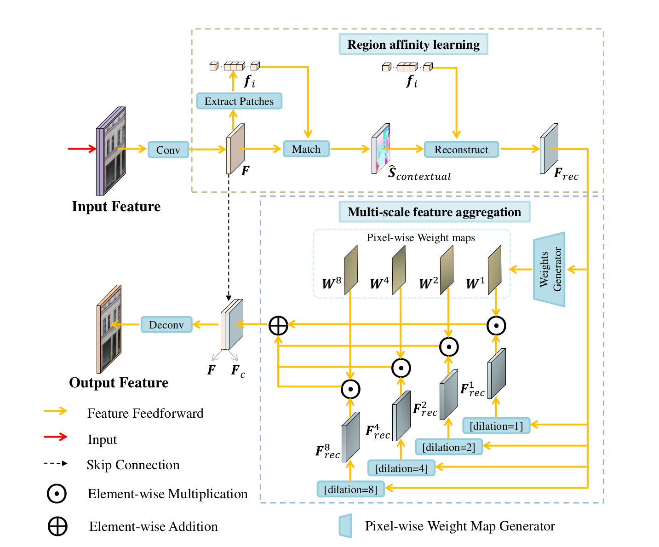
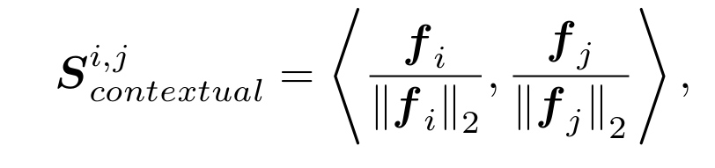
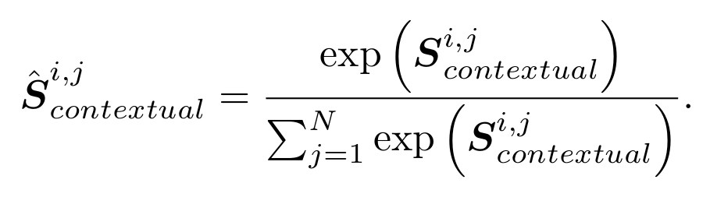
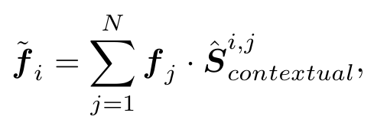
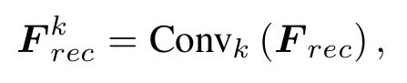
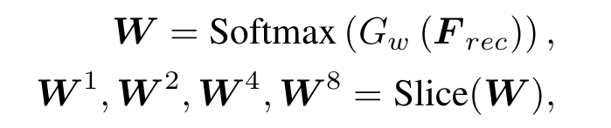
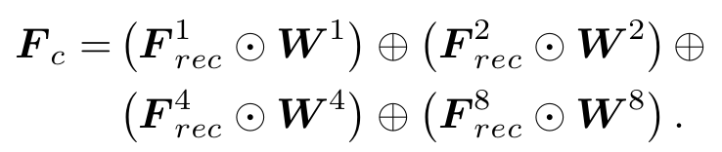
CFA :
Contextual Feature Aggregation (CFA)
Notes:
To better learn which existing regions contribute to filling holes. enhances the correlation between local features of an image and maintains the overall image consistency.
CFA renders low-quality images, and texture filling is sensitive to structure noise.
Given a feature map F , we first extract the patches of 3×3 pixels and calculate their cosine similarities.
The operations above are implemented as convolution, channel-wise softmax, and deconvolution.
four sets of dilated convolution layers with different dilation rates are used to capture multi-scale semantic features
G w consists of two convolution layers with the kernel size of 3 and 1, respectively, each of which is followed by ReLU non-linear activation, and the number of the output channels for G w is set to 4.
Softmax(·) is channel-wise softmax and Slice(·) is channel-wise slice.
but unlike its fixed-scale patch matching scheme, in this study, multi-scale feature aggregation is adopted to encode rich semantic features at multiple scales so that it well balances the accuracy and complexity to handle more challenging cases.

Slide 8
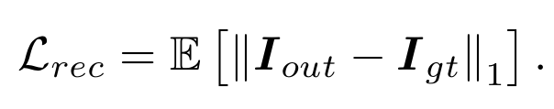
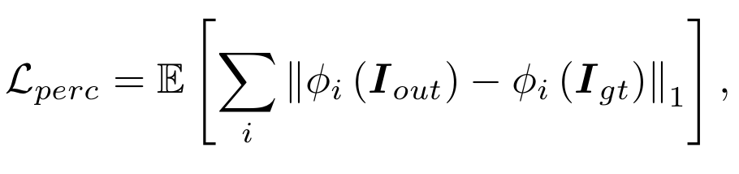
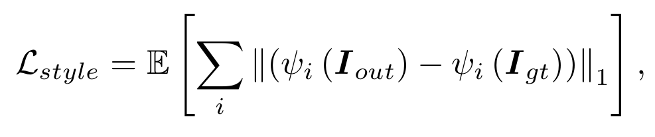
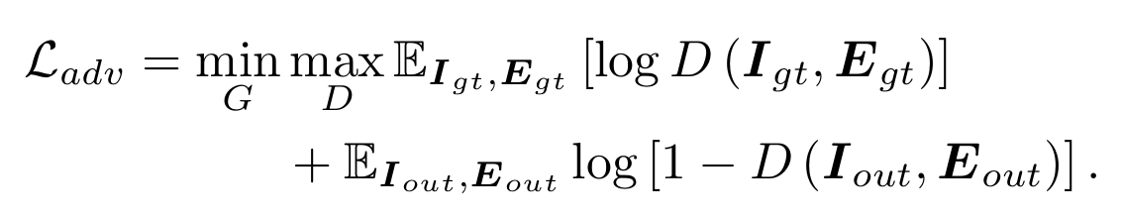
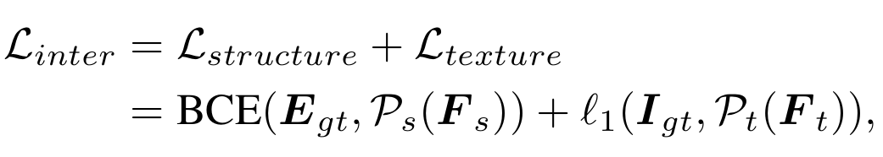
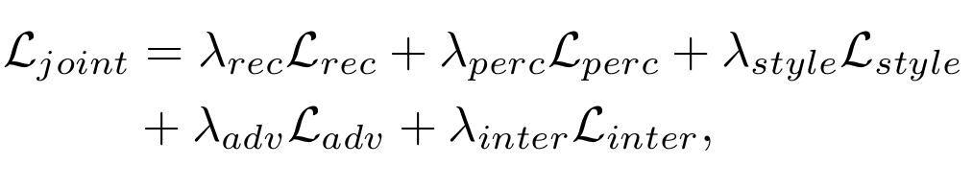
Loss Functions
G : Generator
D : Discriminator
I_{gt} : Ground-truth image
E_{gt} : Complete Edge Map
Y_{gt} : Gray-scale image
M_{in} : Initial binary mask
I_{in} : I_{gt} M_{in} (damaged image)
E_{in} : E_{gt} M_{in} (damaged edge map)
Y_{in} : Y_{gt} M_{in} (damaged gray image)
I_{out,} E_{out} = G(I_{in}, E_{in} ,Y_{in} , M_{in})
: element-wise multiplication
Reconstruction Loss :
Perceptual Loss :
Style Loss :
Adversarial Loss :
Intermediate Loss :
Joint Loss :
Notes:
Reconstruction loss struggles to capture high-level semantics, we introduce the perceptual loss L _{perc} to evaluate the global structure of an image. It measures the L1 distance of I _{out} to I _{gt} in the feature space defined by the VGG-16 network pre-trained on ImageNet.
φ i (·) denotes the activation map of the i-th pooling layer from VGG-16 given the input image I * . In our implementation, pool-1, pool-2 and pool-3 are used.
ψ i (·) = φ i (·) φ i (·) denotes the Gram matrix constructed from the activation map φ i .
Gram matrix captures information about which features tend to activate together. (Correlation)
The adversarial loss is to guarantee the visual authenticity of the reconstructed image as well as the consistency of textures and structures.
Intermediate Loss : To encourage the structure and texture features to be accurately captured by the two decoders, respectively, we introduce intermediate supervisions on F_{s} and F_{t.}
where P_{s} and P_{t} denote the projection functions implemented by a residual block followed by a convolution layer, which map F_{s} and F_{t} to edge map and RGB image, respectively.

Slide 9
Training : Experimental Settings
CelebA, ParisStreetView and Places2 with their original training, testing and validation split.
All the images and corresponding masks are resized to 256 X 256 pixels.
The model is implemented in PyTorch. Training is launched on a single NVIDIA 1080TI GPU (11GB) with batch size of 6.
we first use a learning rate of 2 × 10 ⁻⁴ initial training, then finetune the model with a learning rate of 5 × 10^{-5.}
The discriminator is trained with a learning rate of 1/10 of the generator.
It takes around 4 days to train the models on CelebA and Paris StreetView and 10 days on Places2.

Slide 10
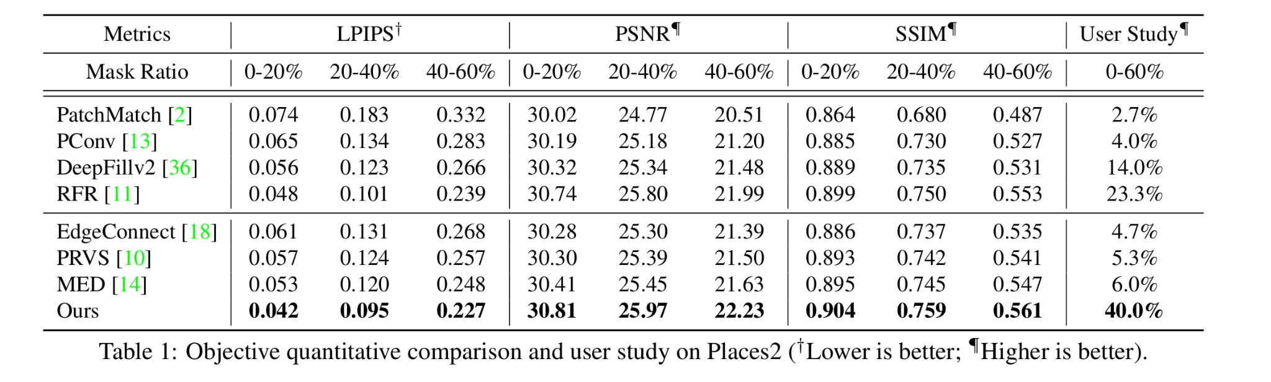
Results
Qualitative and quantitative experiments on the CelebA, ParisStreetView and Places2.
Notes:
10 volunteers with image processing expertise are involved in this evaluation. They are invited to choose the most realistic image from those inpainted by the proposed method and the representative state-of-the-art approaches. Specifically, each participant has 15 questions, which are randomly sampled from the Places2 dataset. We tally the votes and show the statistics in Table 1.

Slide 11
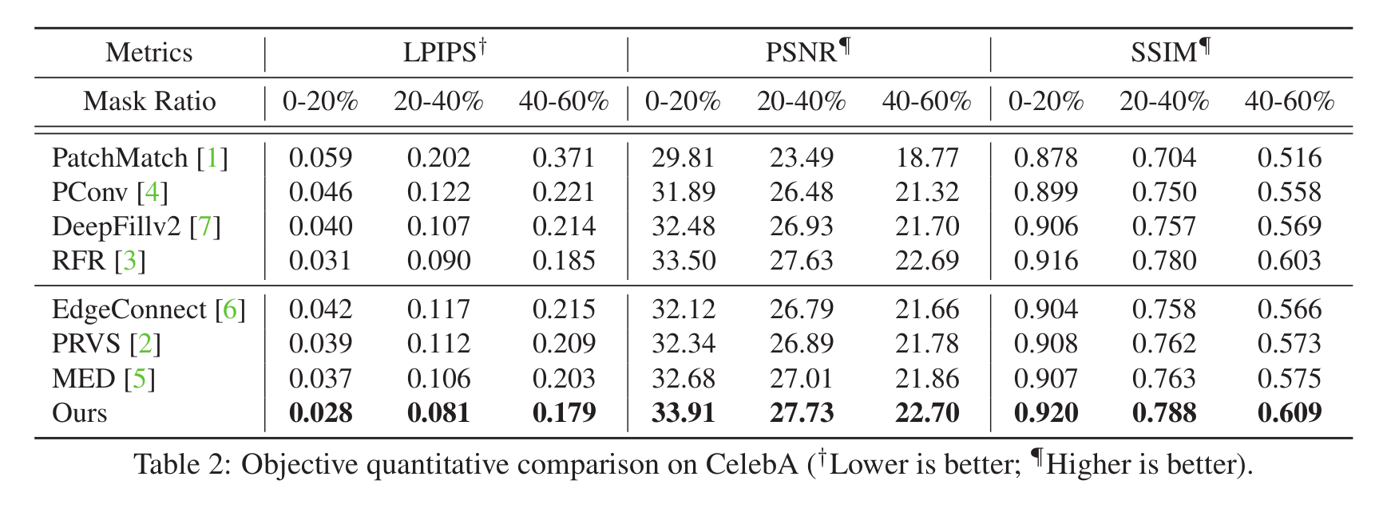
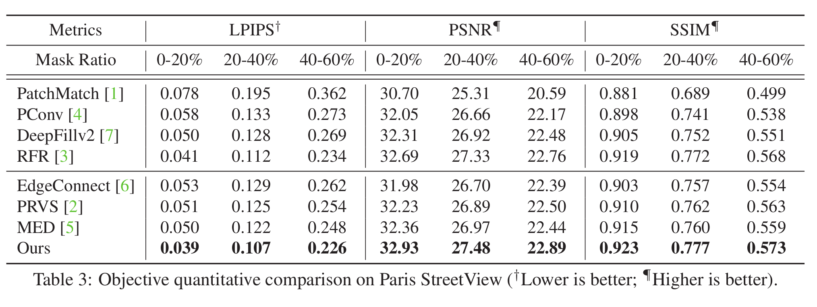
Results

Slide 12
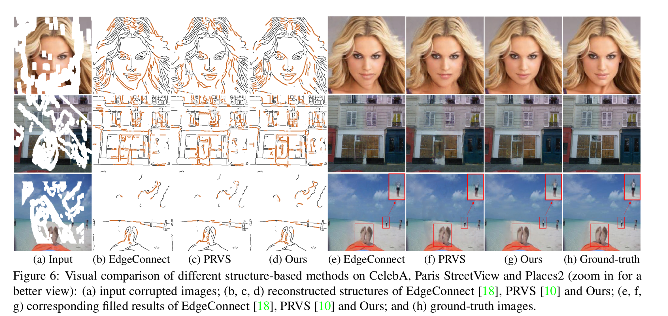
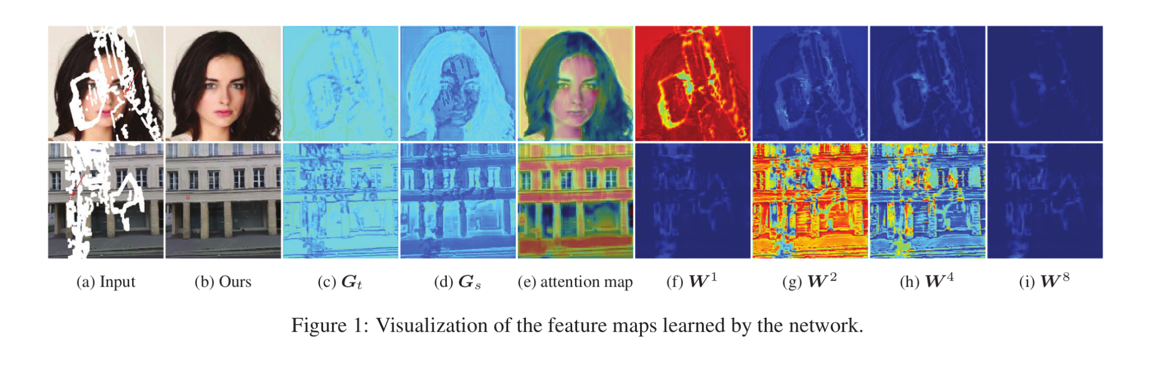
Comparisons

Slide 13
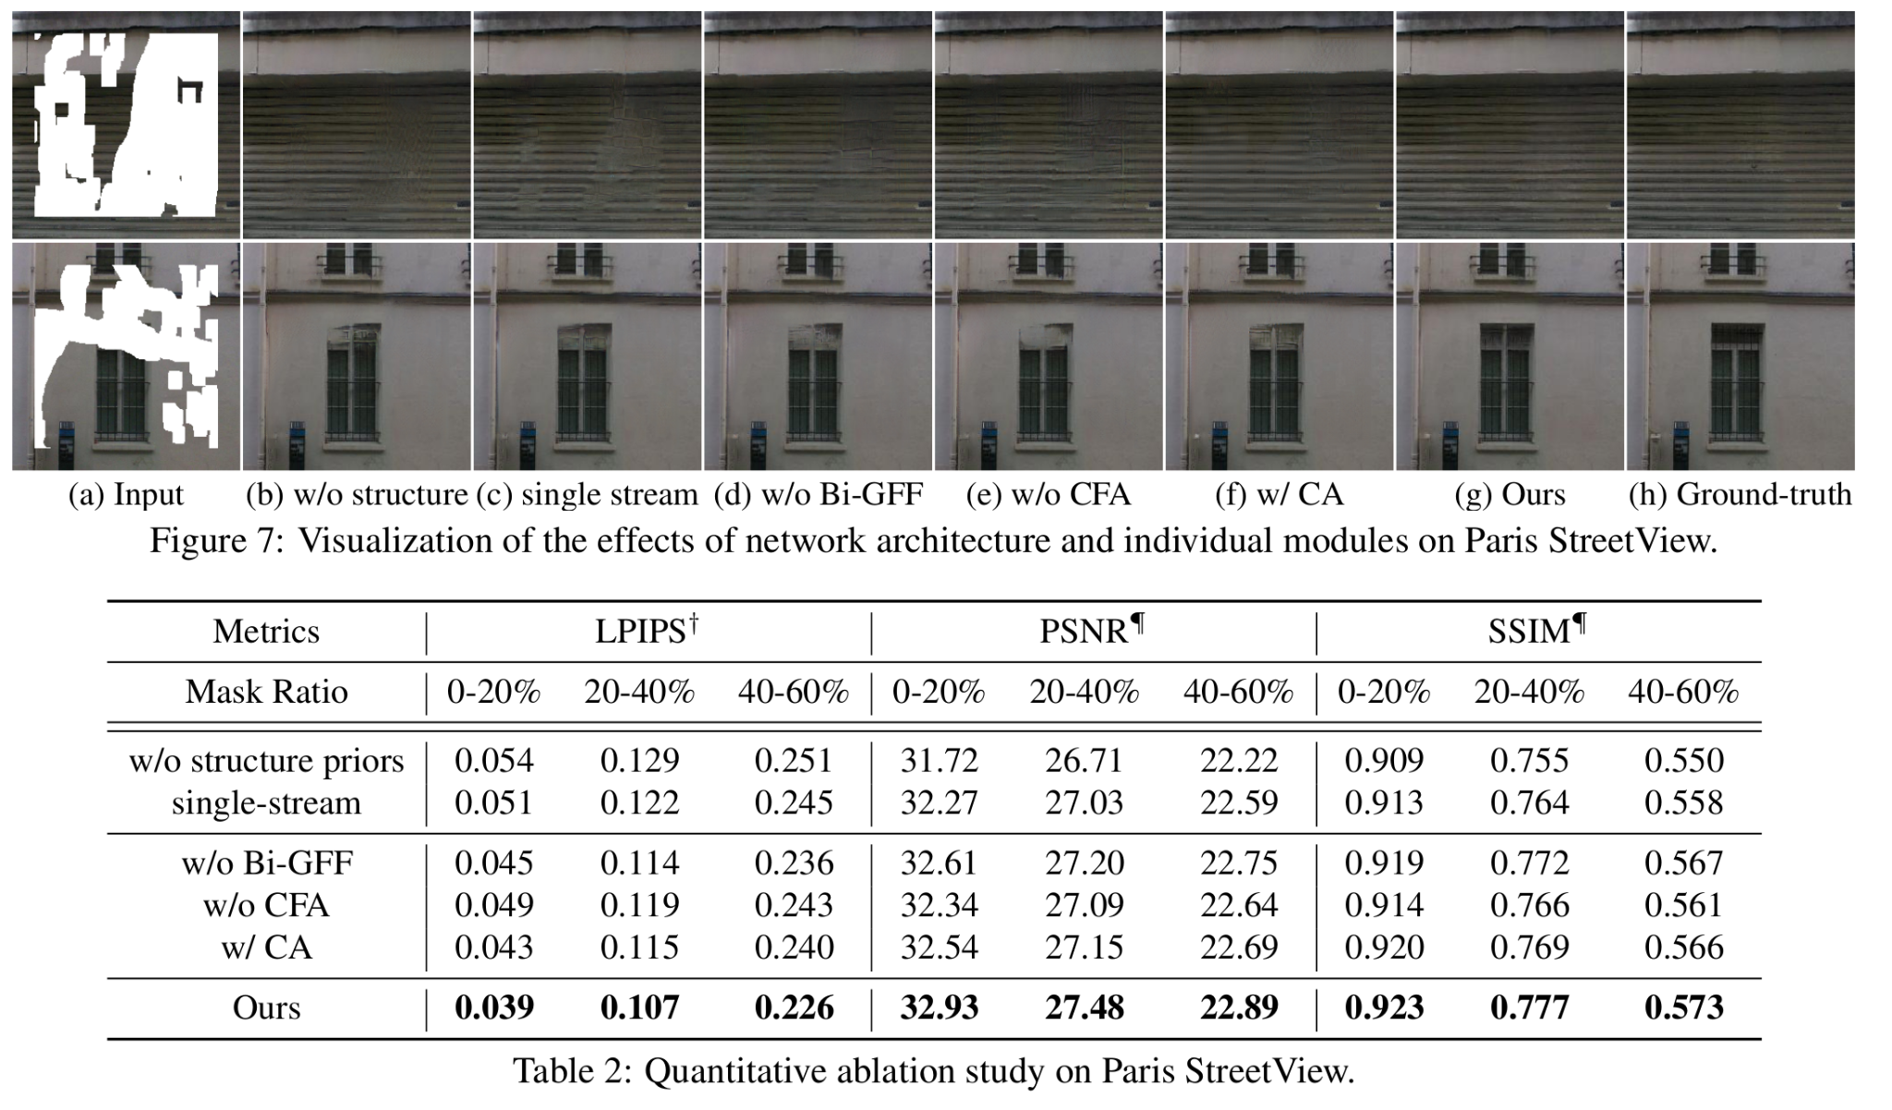
Comparisons
Notes:
Single-stream network method does not well deal with complex structures and tends to smooth out the detailed textures in case of large corruptions

Slide 14
Thank You

